Slide 1
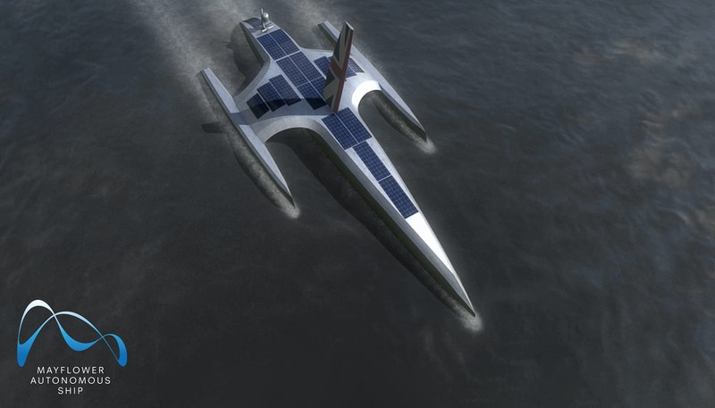
Mayflower Autonomous Ship
Juan Pablo Velandia Suárez / 45161133
Harold David León Hurtado / 45161031
Present to : Ing José Tumealan

Slide 2




Developers
Notes:
developers are from UK
Promating Marine Reachers and Exploration
IBM , this company make PLC , Robots , in general Automations around the world
THE DEVELOPMENT TEAM WAS 31 PEOPLE

Slide 3
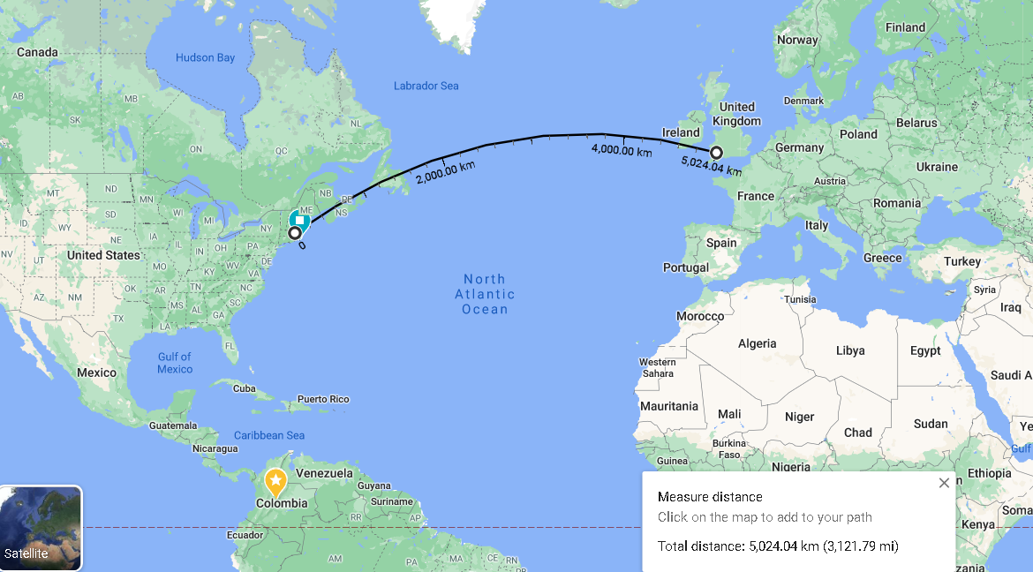
What this the new ?
Notes:
one of the world's first full-sized self-navigating ships
will set sail from the United Kingdom's Plymouth Harbor and traverse the Atlantic Ocean to Cape Cod
this trip will cover more than 5 thousan kilometers
five thousand twenty-four[kilometers of the trip} Zero people on the ship, this ship sails by schedule

Slide 4
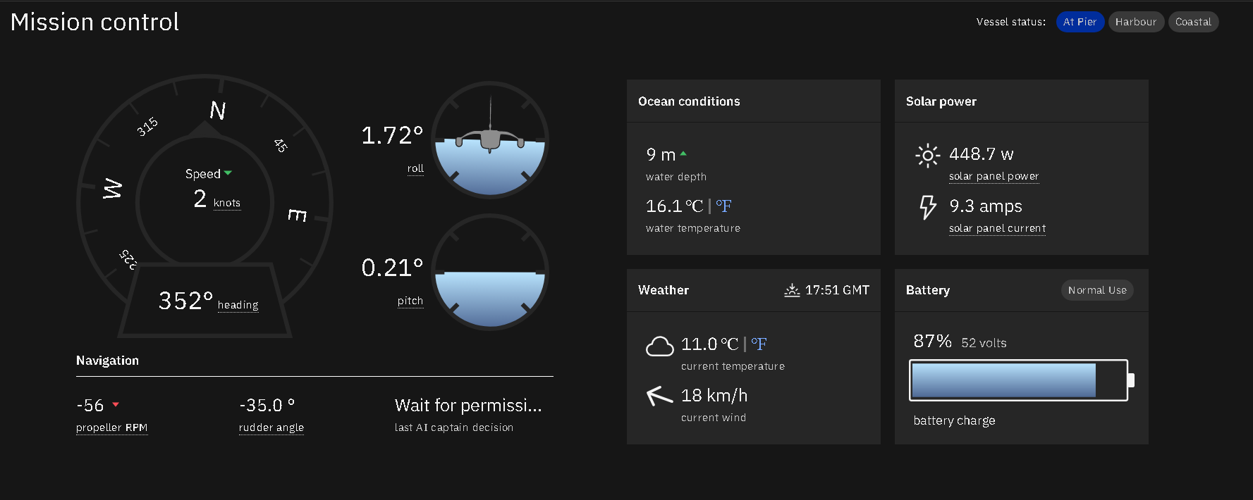
Website

Slide 5
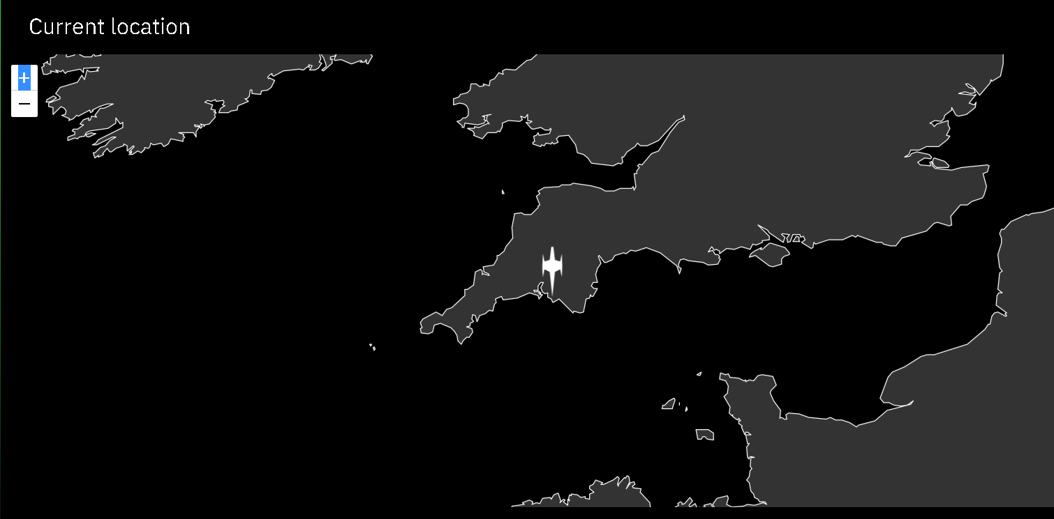
Current Location
Notes:
This locations is England , the trip will start in 21 march 2021

Slide 6
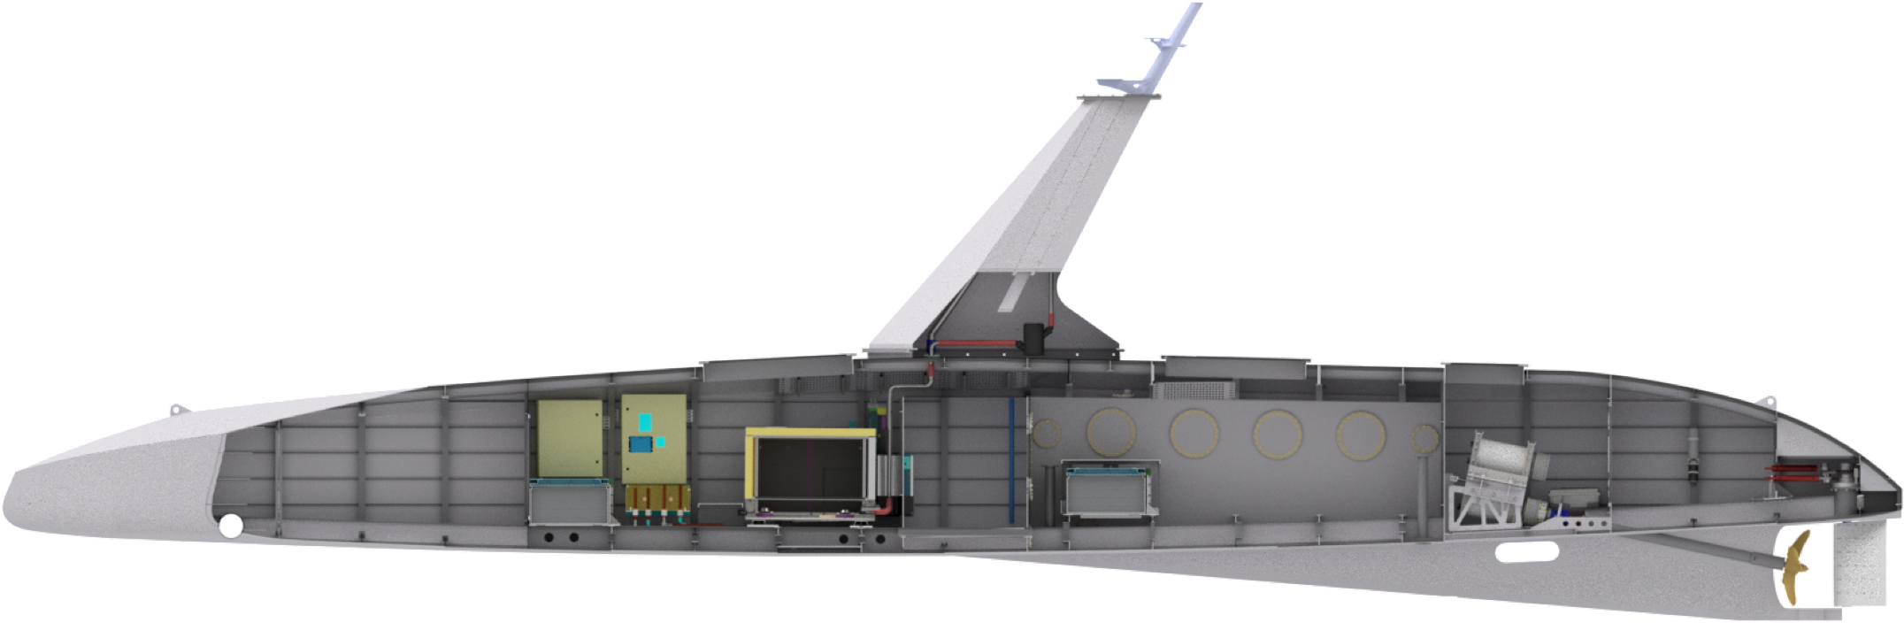
Mayflower
AI captain
Machine learning
Dual motors
Ship Design
Edge computing systems
Power supply
Cargo bay

Slide 7
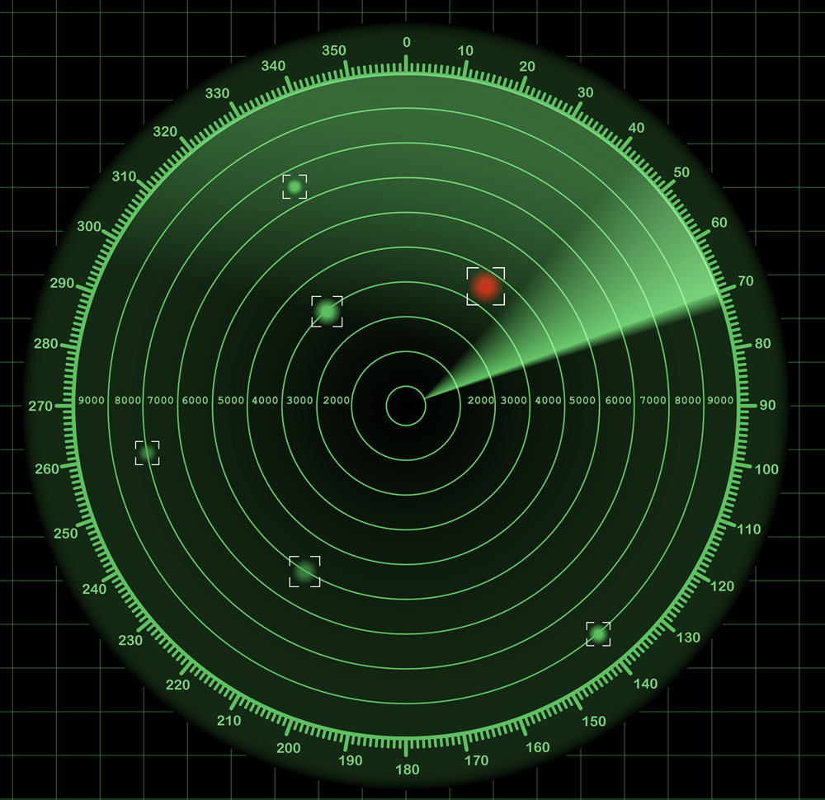
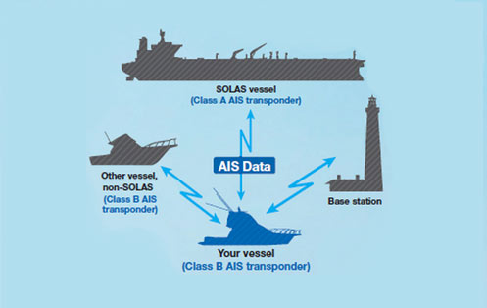
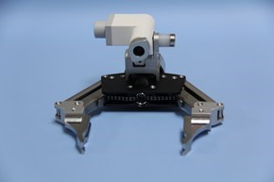

SENSORY INPUTS
Radar
Automatic Identification System (AIS)
Onboard cameras
GPS

Slide 8
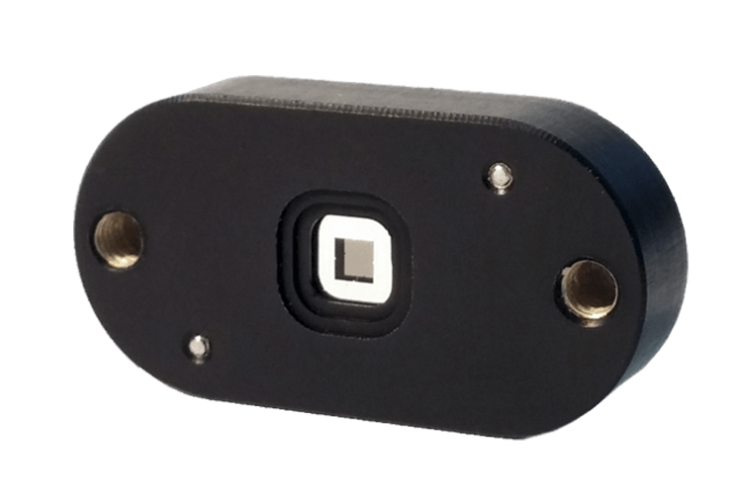

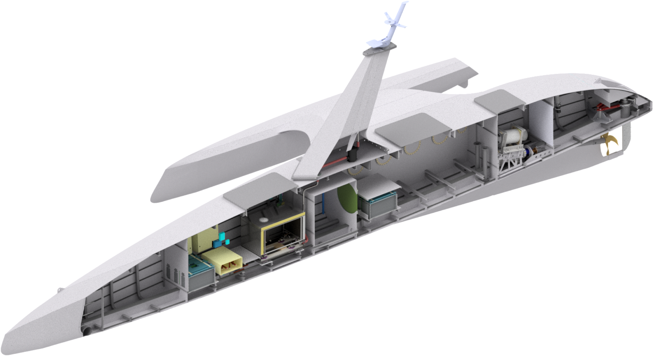
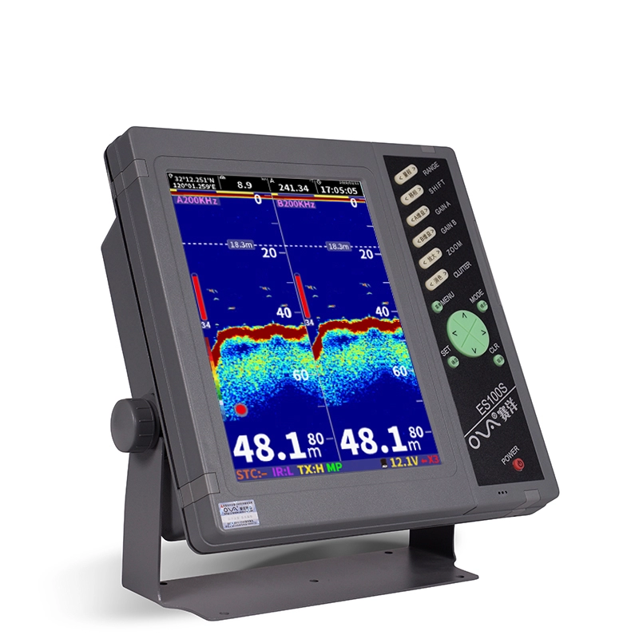
SENSORY INPUTS
Attitude Sensors
Vehicle Management System
MAS’s nautical chart server
Fathometer

Slide 9
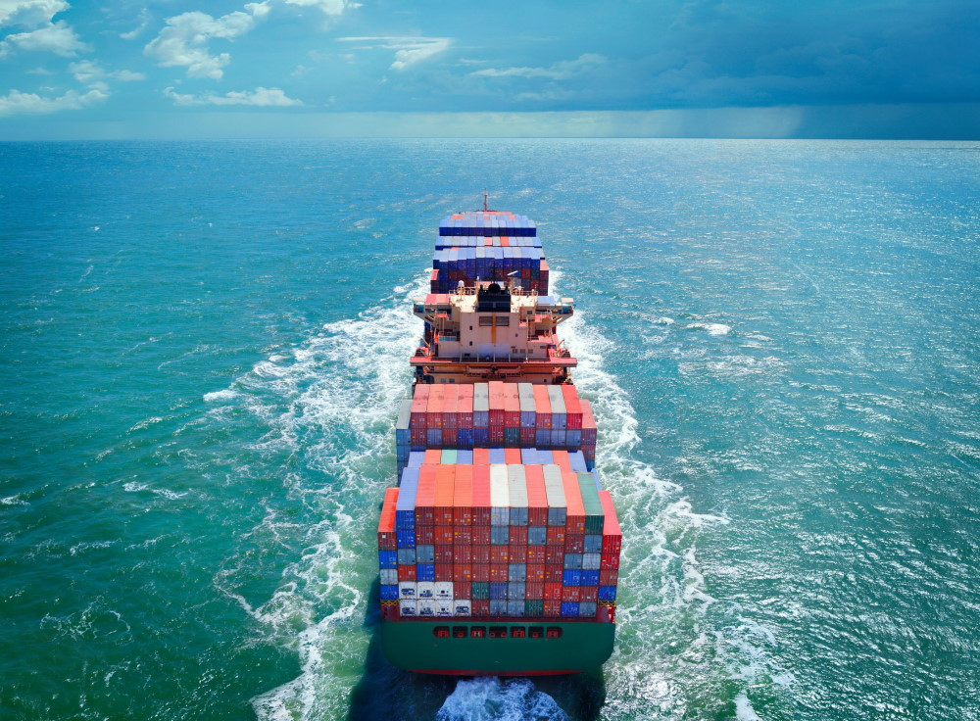
Swift outcomes
AI Captain determines the best action for MAS
MAS’s Safety Manager verifies the decision is safe.
AI Captain instructs MAS’s Vehicle Management system to change course and speed.

Slide 10

Obtained from https://mas400.com/technology

